Slide 1
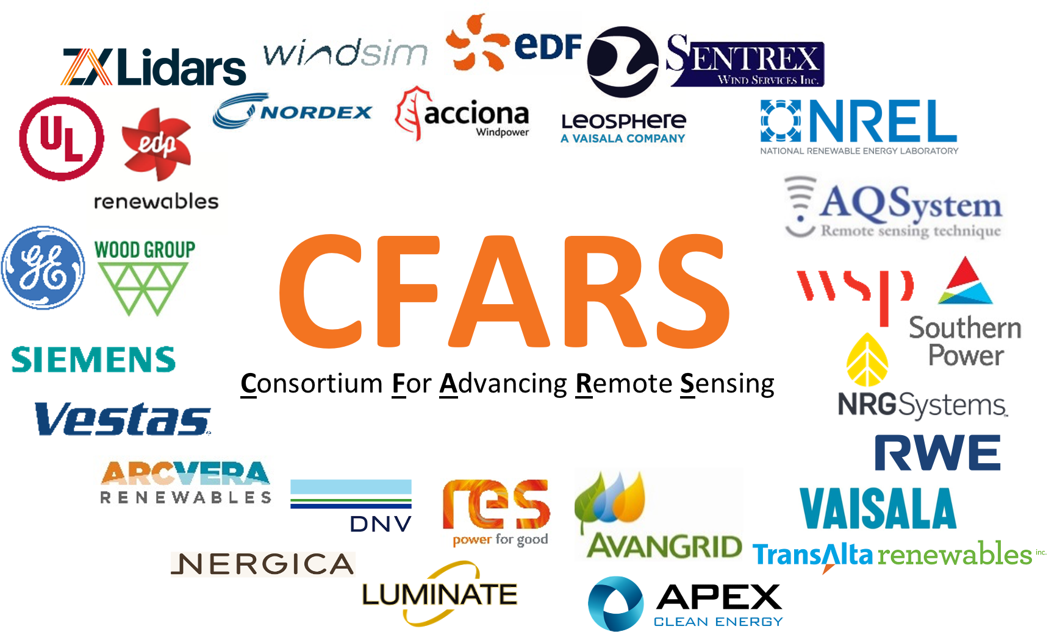
Site Suitability Subgroup: Accelerating Data-Driven Guidance for RSD TI Corrections
CFARS General Meeting
April 13-15, 2021
Alexandra E. Arntsen, NRG Systems
aea@nrgsystems.com
Alexandra St. Pé, RWE
alexandra.st.pe@rwe.com

Slide 2


Who Are We?
Diverse group of engaged stakeholders
Europe and North America
Research: 9
Consultants: 17
Owners/
Developers: 16
Turbine
OEMs: 5
Lidar OEMs:
8
Where are we plugged In?
Conference presentations:
Upcoming presentation April 20th AMSE Wind Digital Solutions Summit
Past presentations at Wind Europe, AWEA Wind Resource & Project Energy Assessment Conferences
External Alignment
Meet to update and share progress regularly with IEA Task 32 and industry IEs to ensure the best alignment possible

Slide 3



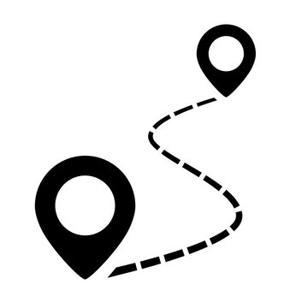
Agenda
Function and approach of the
Site Suitability Subgroup
Leveraging an open source approach: TACT
Best practice framework
Roadmap

Slide 4
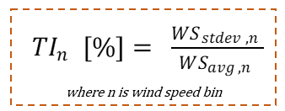
CFARS Site Suitability Subgroup: Motivation
Site Suitability Subgroup Focus: Turbulence Intensity
It is imperative that we accurately measure and understand a project site’s TI conditions during a pre-construction site suitability assessment:
For choosing a suitable turbine
For optimal suitability modeling to ensure an appropriate operating strategy

Slide 5
The Site Suitability Subgroup
Challenge
Action
Result
A demand for greater understanding and minimization of the bias between remote sensing devices and cup anemometers for turbulence intensity (TI) measurements
Collaboration between a variety of stakeholders to share and test methods for adjusting and benchmarking turbulence intensity from RSDs
Open source tool to compare and assess multiple adjusted RSD TI methods’ performance using best-practice TI evaluation metrics and sensitivity analyses on a site-by-site basis
Development of best practice framework for stakeholder collaboration, which leverages the open source tool, to determine acceptable loads bias thresholds from adjusted RSD TI

Slide 6
Advantages gained by adopting an open source model …

Slide 7
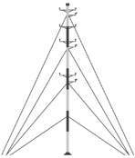
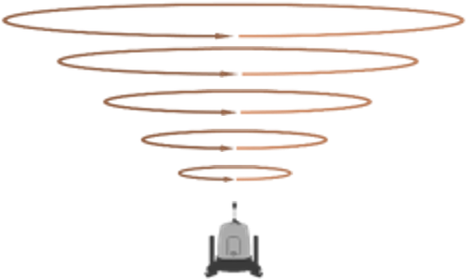
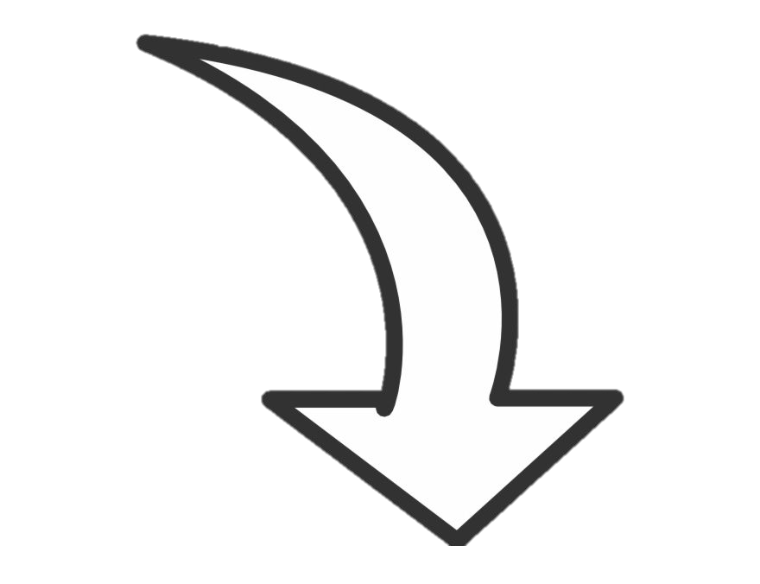


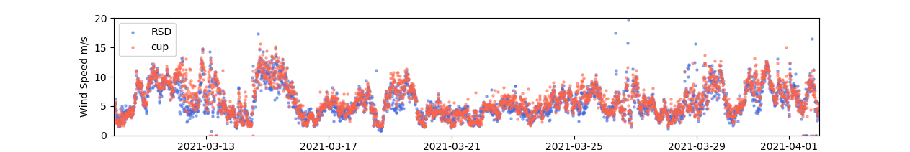

Advantage #1
TACT.py
site-specific project results
Config File
(select metadata)
processes data
standardized results
project data
Open
Open
Open
Closed-data open-methods enabled by opensource tool design
https://github.com/CFARS/site_suitability_tool

Slide 8
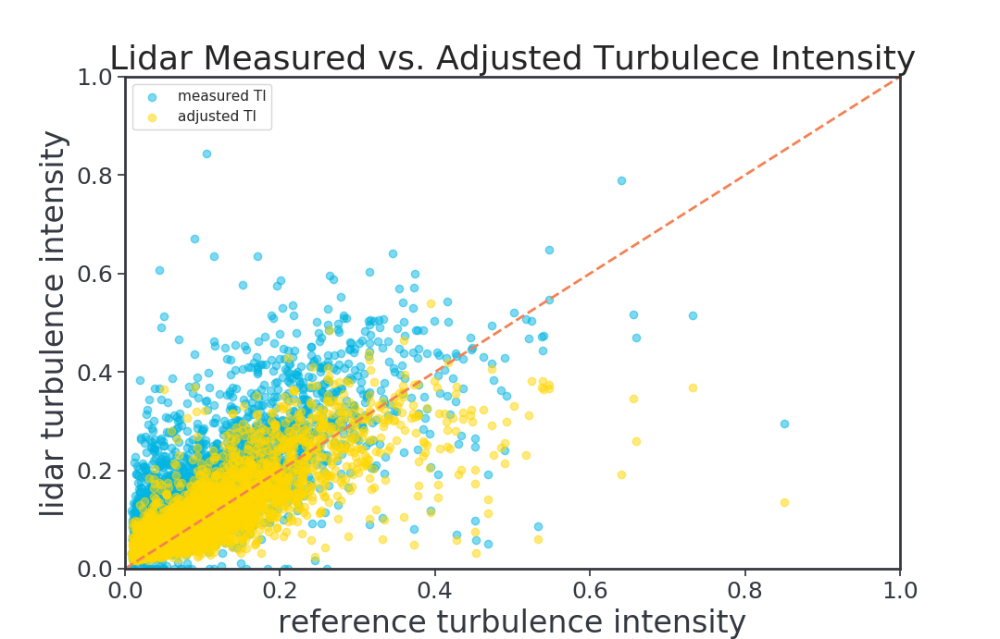
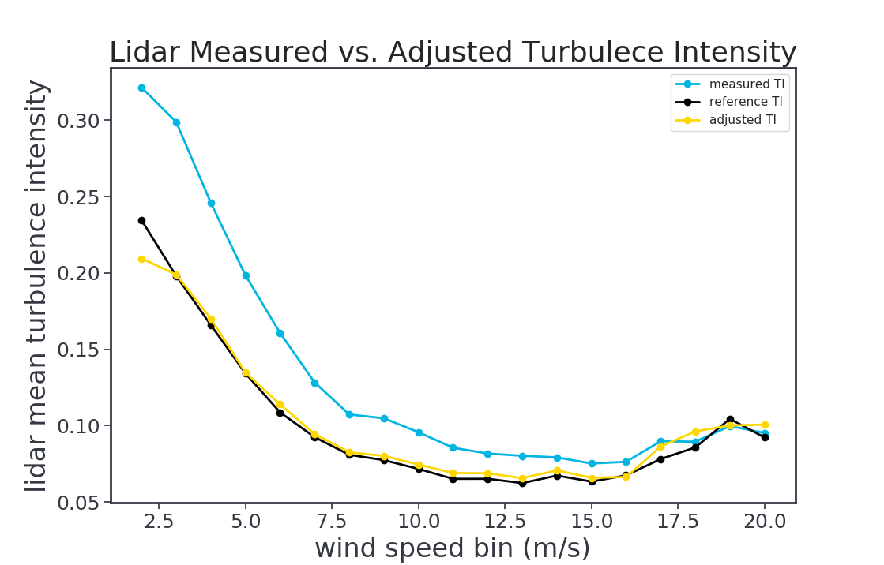
Advantage #2
Collaboration = a better product
TACT.py

Slide 9

Advantage #2
Collaboration = a better product
Consensus on comparison metrics
Mean Bias Error
Root Mean Square Error
TACT.py
Distribution similarity tests

Slide 10

Advantage #2
Collaboration = a better product
Consensus on comparison metrics
16 different adjustment variations
Range of complexity:
Slope and offset adjustments
Machine Learning methods
Raw 1 Hz physical and spectral based corrections
Sharing of Adjustment methods
TACT.py
Aimed to address stand alone deployment as well as use with a collocated tower

Slide 11
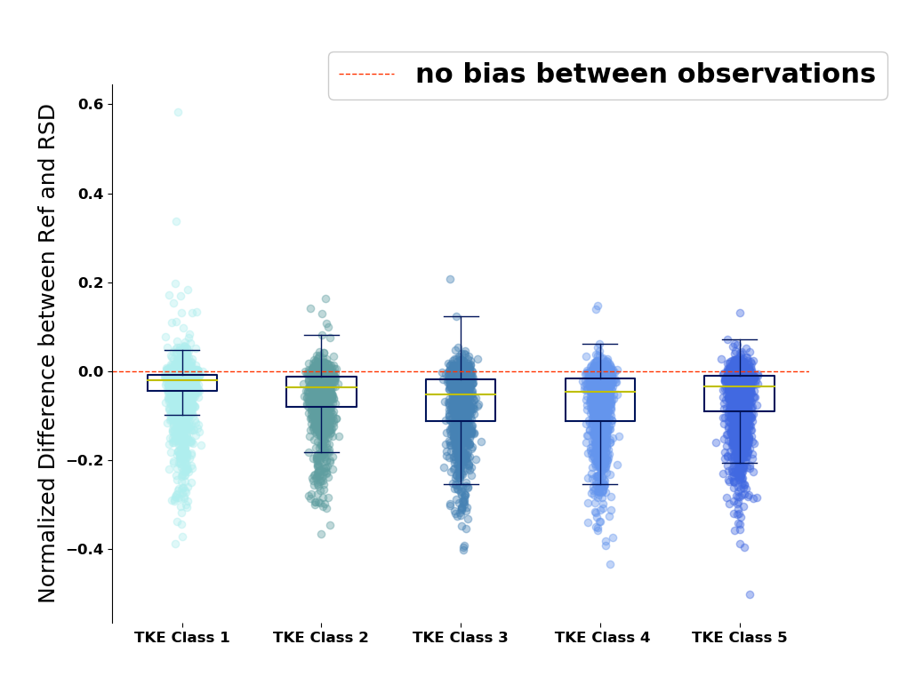
Advantage #2
Collaboration = a better product
Consensus on comparison metrics
Sharing of Adjustment methods
TACT.py
Testing/
incorporating sensitivities
We observed preliminary evidence for a statistically discernable difference between TI observation bias when classifying by TKE

Slide 12
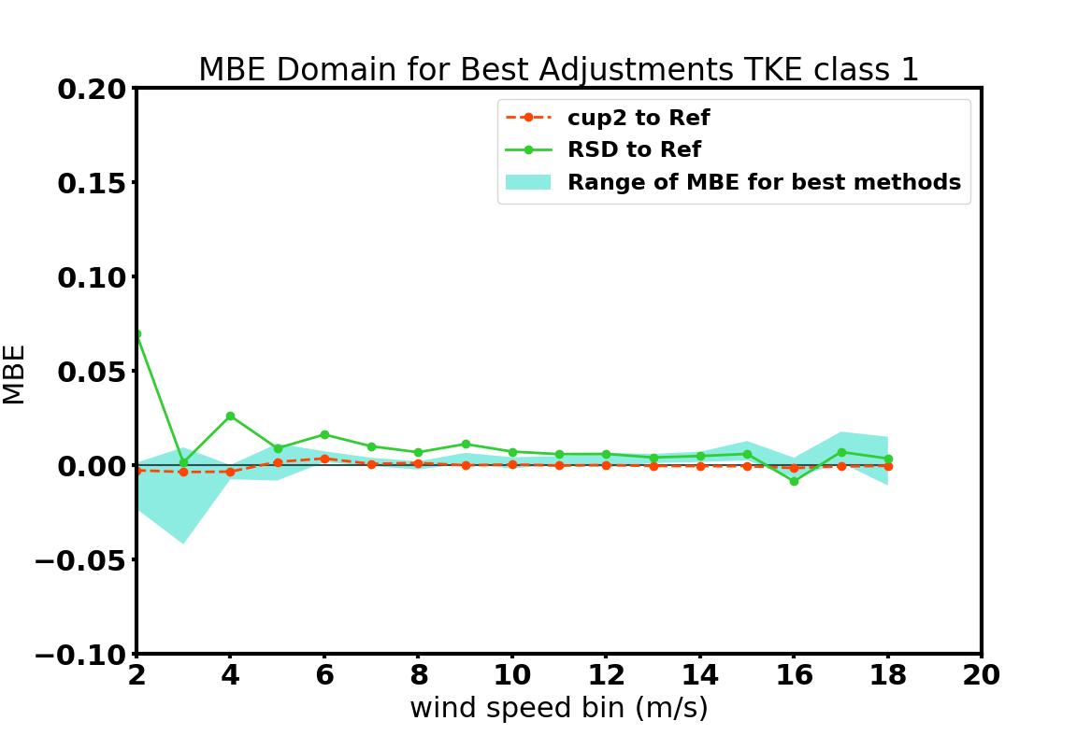
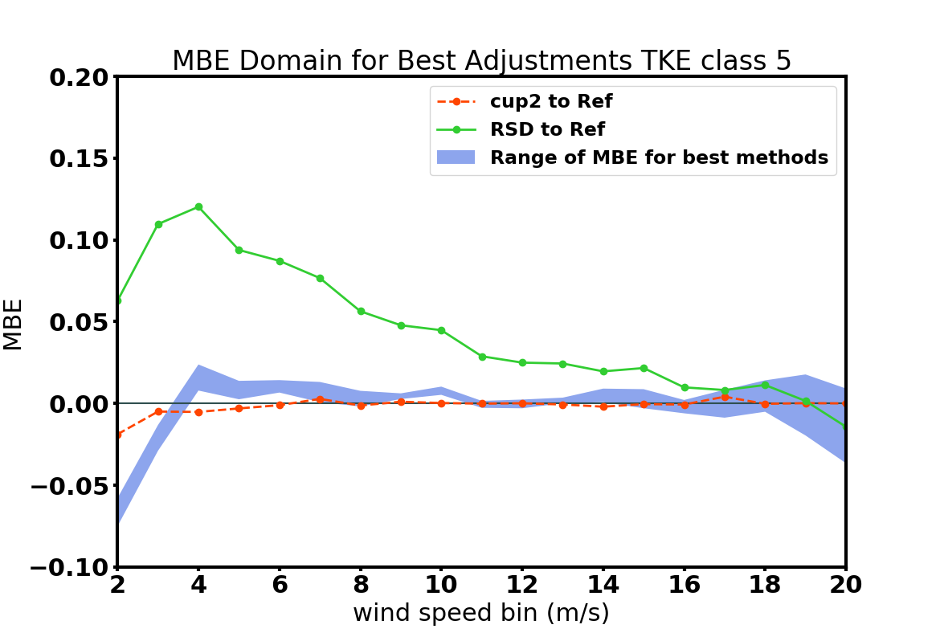
Advantage #2
Collaboration = a better product
Consensus on comparison metrics
Sharing of Adjustment methods
Adjustment method performance by TKE
TACT.py
Testing/
incorporating sensitivities = TKE & time of day aware methods

Slide 13
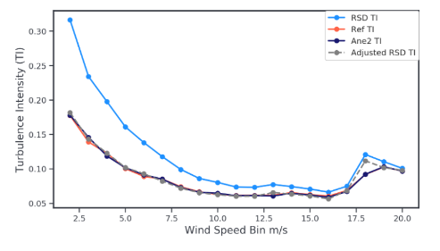
Advantage #2
Collaboration = a better product
Consensus on comparison metrics
Sharing of Adjustment methods
TKE aware adjustments
TACT.py
Testing/
incorporating sensitivities = TKE & time of day aware methods
4 | 5 | 6 | 7 | 8 | 9 | 10 | 11
12 | 13 | 14 | 15 | 16 | 17 | 18 | 19 | 20
Wind speed bins where mean TI of adjusted RSD data is closer to the reference than a second anemometer

Slide 14
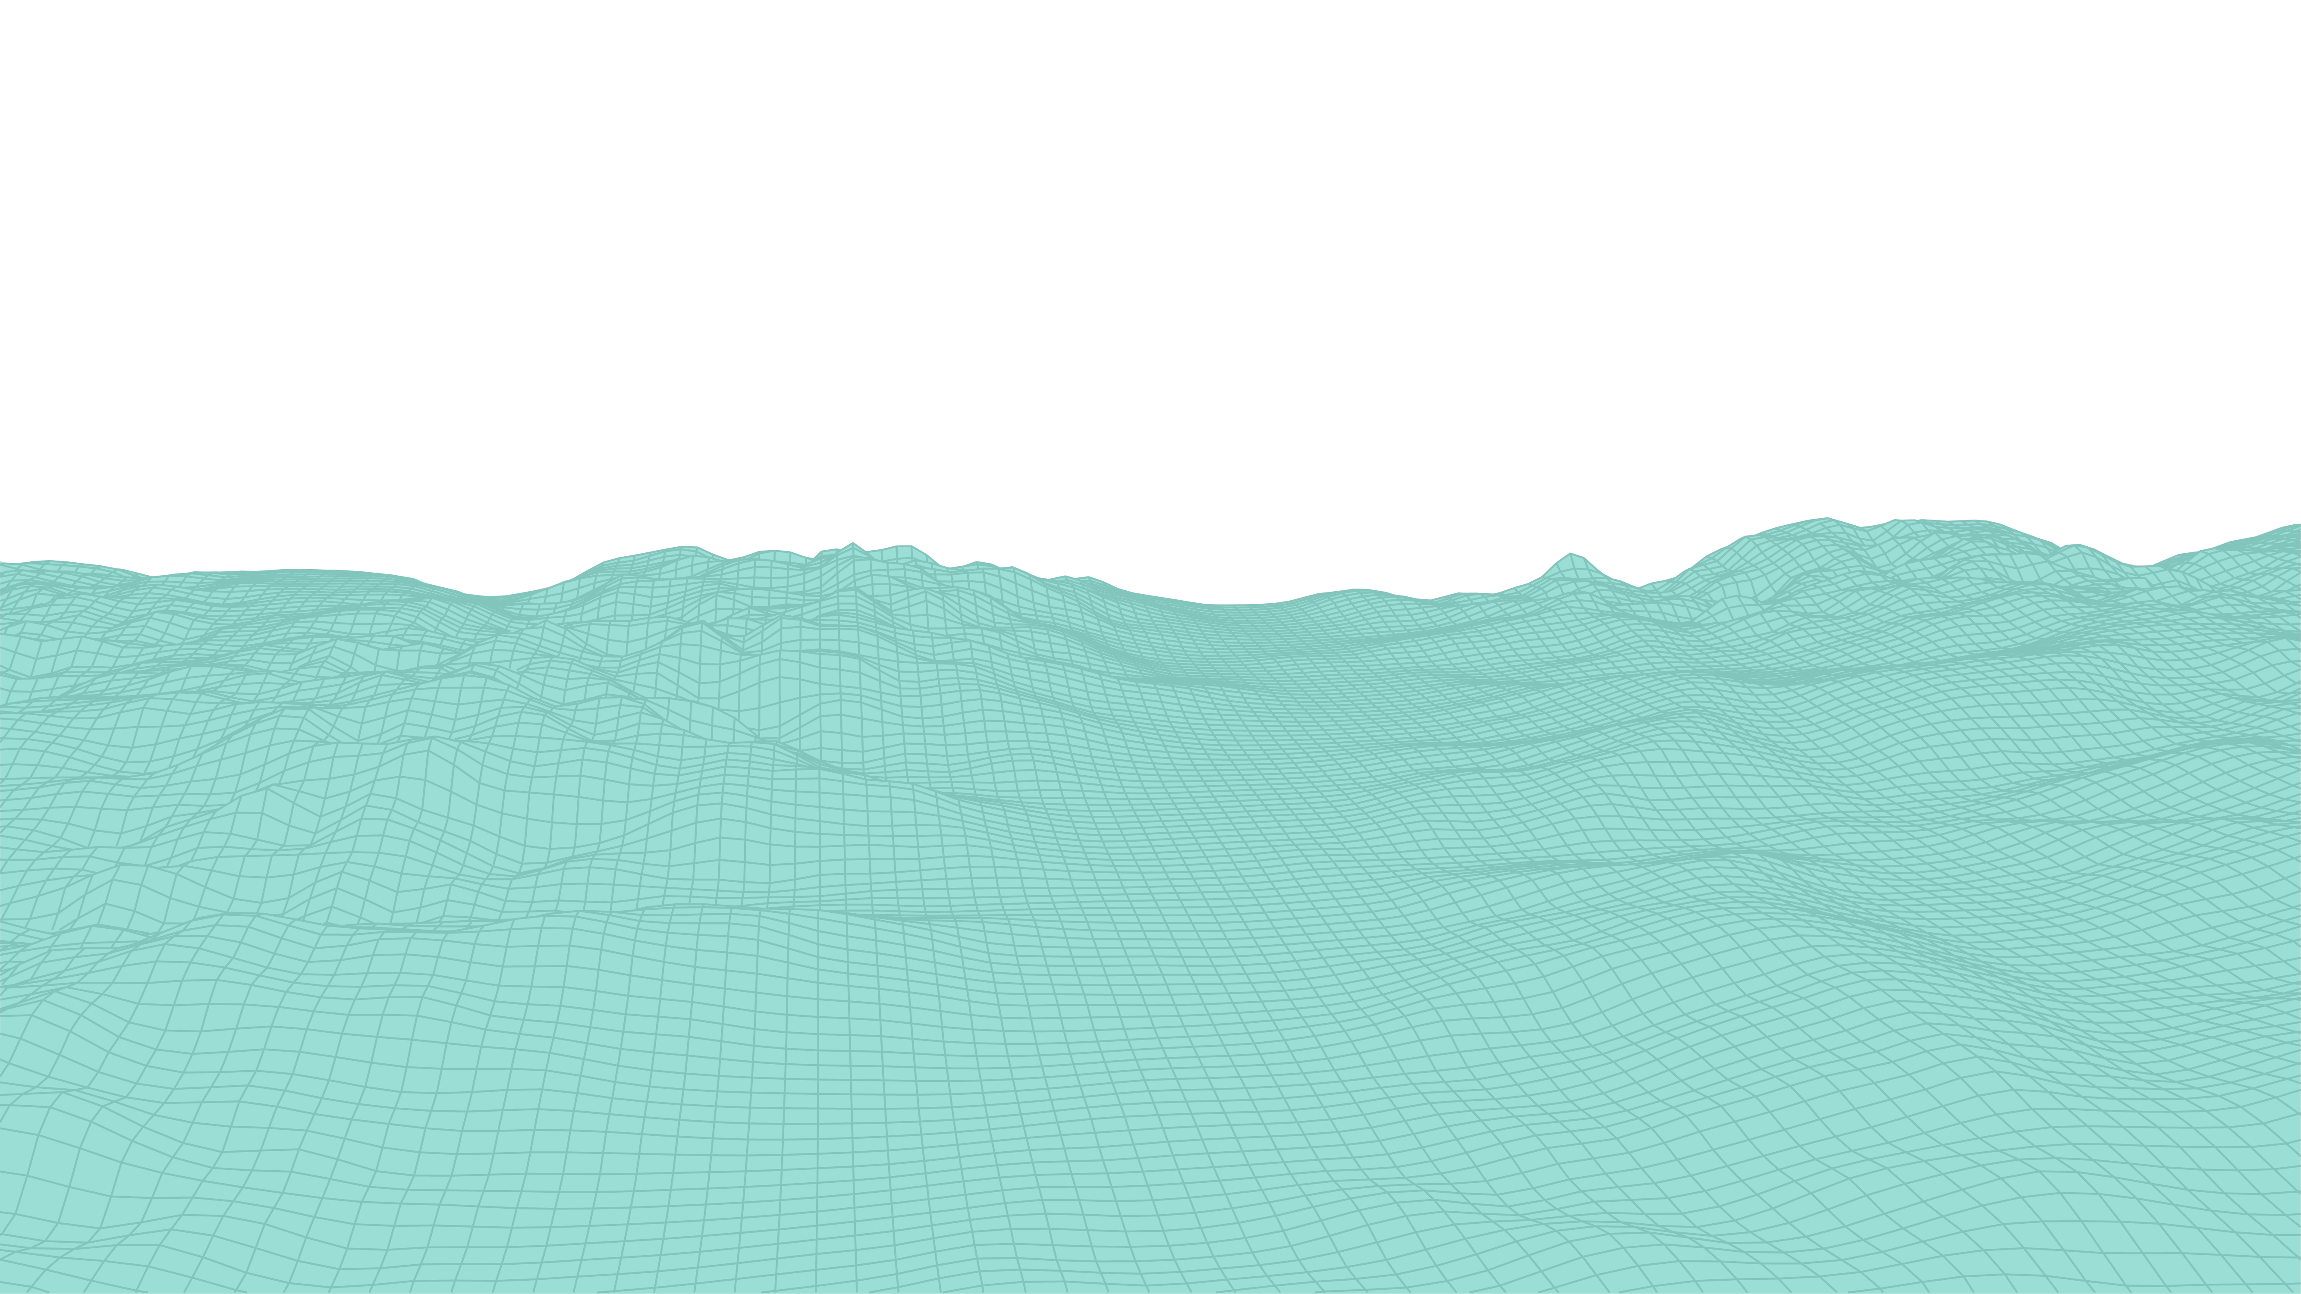
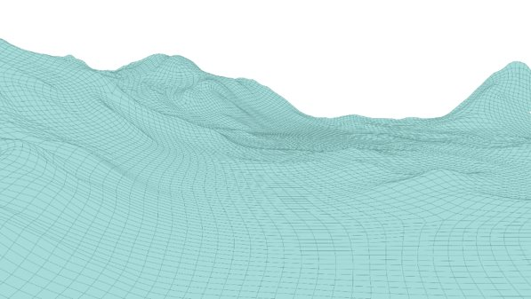
Advantage #2
Collaboration = a better product
Different model generation schemes:
Length of model generation time
Transferability of one model to a new site
Consensus on comparison metrics
Sharing of Adjustment methods
TACT.py
Transferrable?
Adjustment model
Testing/
incorporating sensitivities = TKE & time of day aware methods
Testing sensitivities to model generation schemes
Project site a
Project site b

Slide 15
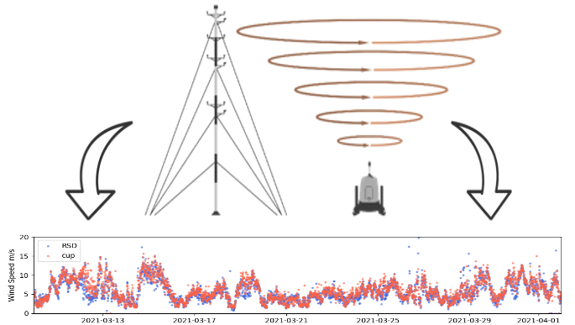
Advantage #2
Collaboration = a better product
Consensus on comparison metrics
Inputs to TACT:
Sharing of Adjustment methods
TACT.py
Config File
Data adjusted
by a proprietary method
(optional)
Data
Interacts with proprietary methods
Testing/
incorporating sensitivities = TKE & time of day aware methods
Testing sensitivities to model generation schemes

Slide 16

Advantage #2
Collaboration = a better product
Consensus on comparison metrics
Representative TI
Consensus on output
Sharing of Adjustment methods
TACT.py
Turbine loads model
Interacts with proprietary methods
Testing/
incorporating sensitivities = TKE & time of day aware methods
Testing sensitivities to model generation schemes

Slide 17
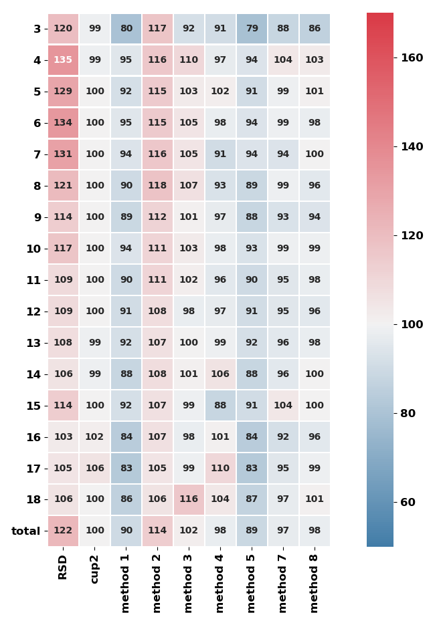
Advantage #2
Blades Component Model Output from Various TI Input
Collaboration = a better product
Consensus on comparison metrics
Consensus on output
Sharing of Adjustment methods
Percent of Reference Cup Load
TACT.py
Interacts with proprietary methods
Testing/
incorporating sensitivities = TKE & time of day aware methods
Testing sensitivities to model generation schemes

Slide 18
Leveraging open source tool for commercial implementation

Slide 19
Best Practice Framework for Stakeholder Collaboration to
Determine Acceptable Loads Bias Thresholds from
Adjusted RSD TI
CFARS Site Suitability
reference analysis from our collaborative study
Owner/
Turbine OEM
Runs TACT
Turbine OEM Inputs TACT Output into Loads Model
Owner +
Turbine OEM Make Informed Decision on
Accepting Adjusted RSD TI for Site Suitability Assessment
IE + Turbine
OEM Choose Acceptable Load Bias Threshold from Adjusted RSD TI
Key IE & Turbine OEM ask
Notes:
CFARS will not declare acceptable bias threshold for proprietary load models
Clarity we are empowering more knowledge about industry standard practices - not creating new science
More focus on what in TACT in WP
More explanation on why we did benchmark 1

Slide 20
Roadmap
White paper publication Early May 2021
We are in the final stages of review. Circulation goals have been met, finishing addressing reviewer comments.
Data Submissions (TACT output results) and Analysis Spring and Summer 2021
Ongoing
Looking for anyone that would like to submit project results – contact me!
Looking for analysis and TACT improvement/maintenance help – contact me!
Required for progress
Skills: Python, analysis, data science, data visualization, interest in the subgroup’s mission
Technical Results paper Fall and Winter 2021
Will be dependent on increased man/woman power

Slide 21
Thank you!
Alexandra Arntsen (NRG Systems)
aea@nrgsystems.com
Alexandra St. Pé (RWE Renewables)
alexandra.st.pe@rwe.com

